Slide 1
Trade Surveillance system
Future of Financial Fraud Prevention
Team Watch Dogs:
Shriniwas Nayak
Shweta Barge
Saloni Agiwal
Akshat Mehta
Ravi Kumar Varudhu
Project Link:
https://github.com/ShwetaBarge/TradeSurveillance
Notes:
https://github.com/ShwetaBarge/TradeSurveillance

Slide 2
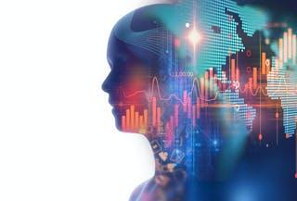
Trade Surveillance System
This project:
1.Detects all possible front running
scenarios and wash trades involved in trading activity
2.Provides alerts to middle office surveillance system whenever a fraud action is detected

Slide 3


Project Overview
Front Running Sell-Sell-Buy and Buy-Buy-Sell scenario detection
Wash Trade Detection
Identification of Brokers in fraud activities
Automated Trade surveillance system in middle office to detect all possible front running scenarios
Fraud report generation of all trades involved in front running scenarios and wash trades

Slide 4
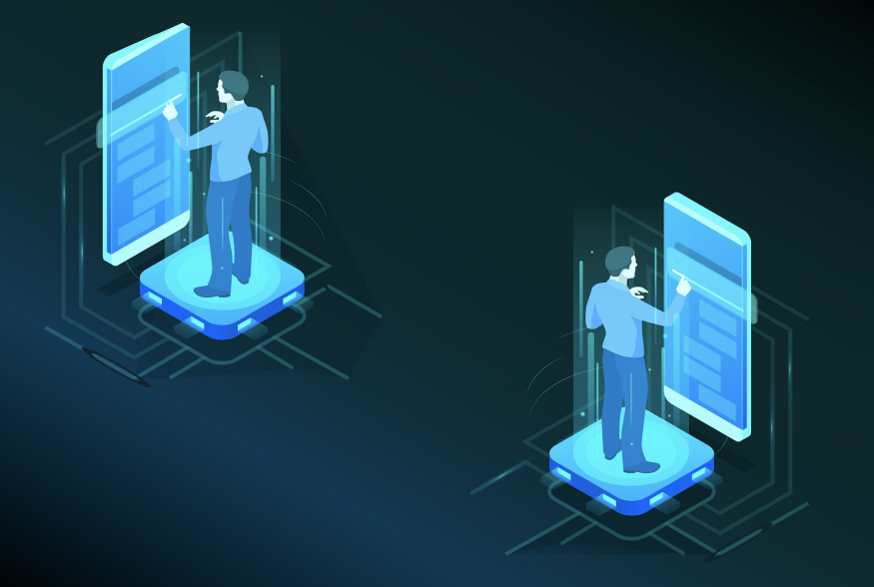
Front Running Scenario
Any illegal practice of purchasing a security based on advance non public information that will affect price of security.
This project deals with major front running scenarios and provides an alert, if found.

Slide 5
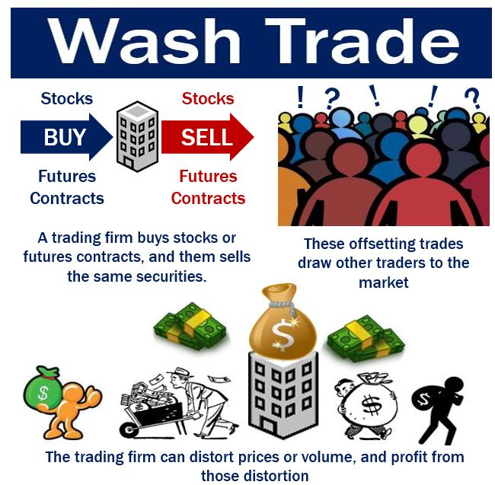
Wash Trades
Market manipulation in which investor simultaneously sells and buys same financial instruments to create misleading activity in marketplace.
This project detects all wash trades present in the trade list and alerts the surveillance team.

Slide 6

Workflow Model
Front Office
Middle Office
Customer places a trade through broker from front office
After trade confirmation middle office surveillance system analyzes all trades and detects possible fraudulent activities
Once the fraud is detected Surveillance team cross check and validate the trade and takes action on brokers involved, if any fraud found out to be true.

Slide 7
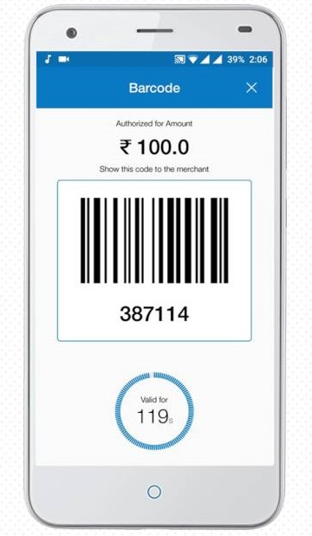
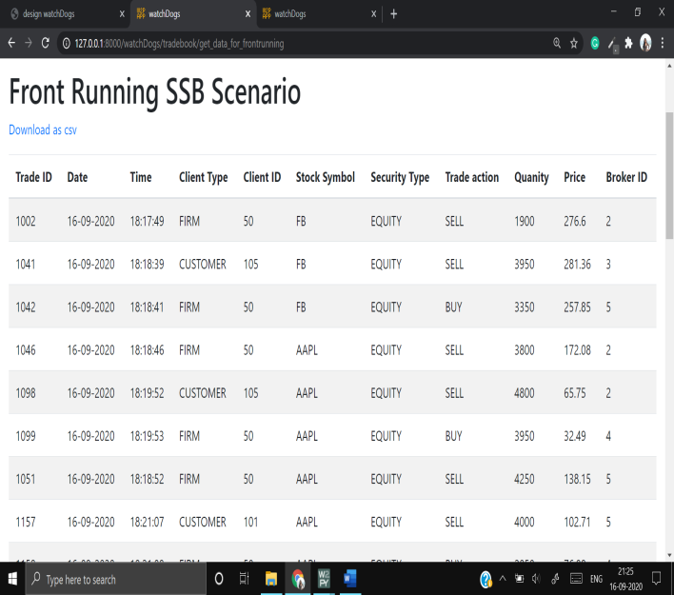
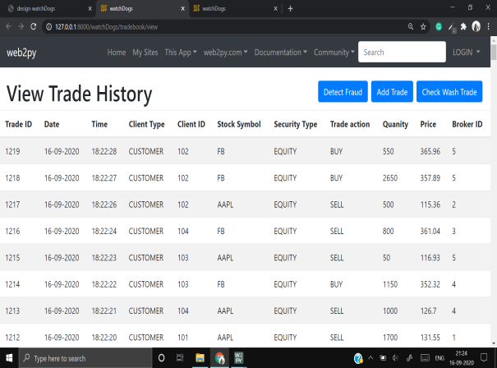
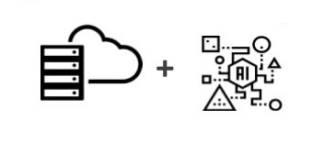
USE CASE: Front Running Detection
Front office gets the live trading information
Alert raised on detection of front running scenario
New Trade Action
Middle Office
2-step verification
User response to buy or sell financial instrument
Data is processed in the middle office and used to verify front running scenario
Trade Surveillance team validate the detection and takes necessary action

Slide 8
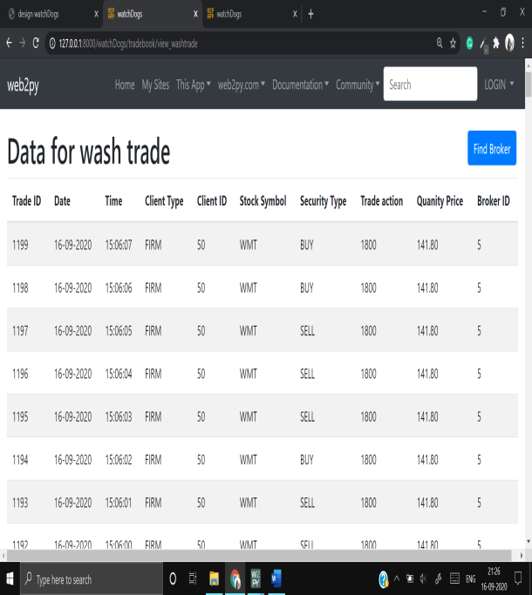
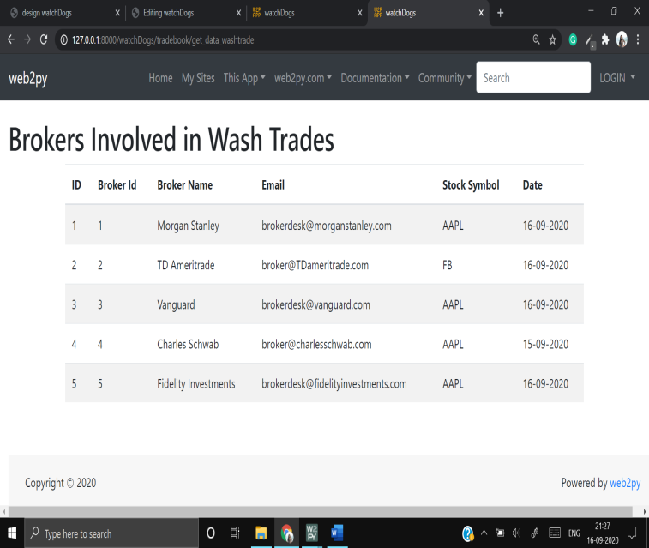
USE CASE: Wash Trade Detection
Middle office gets the live trading information related to wash trades
Alert raised on wash trade detection and broker details involved in the trades are sent.
New Trade Action
Middle Office
2-step verification
User response to buy or sell financial instrument
Data is processed in the middle office and used to verify wash trading scenario
Trade Surveillance team validate the detection and takes necessary action on broker

Slide 9
Algorithm for Trade Data Random Generation
Initialize stock symbol list , price list
Initialize size of customer orders
Select parameters for customer order and store in customer order table
Traverse customer order table
1.if quantity> threshold
choice=commit_fraud
if(choice)
generate BBS/SSB
Add order in tradebook

Slide 10
Algorithm for Front Running Detection
Retrieve all firm orders and customer orders where quantity>threshold
Traverse over firm order
Generate nested dictionary on basis of date,action and stock symbol
Traverse over Customer order
if action==buy
find buy with lesser timestamp and sell with higher timestamp
else
find sell with lesser timestamp and buy with higher timestamp
if both orders are present
check if security type is same
Raise alert to middle office team

Slide 11
Algorithm for Wash Trade detection
Retrieve firm orders
Traverse firm orders
Segregate order on basis of date,action stock symbol
Calculate security worth=volume*price
Assign security worth positive if buy else negative
Traverse dictionary
For every list find size of largest subset with netting zero
if size>threshold alert the middle office surveillance team.

Slide 12

TECH STACK
Framework
APACHE
Python
+
HTML
Firebird
Request/Response
SQLite
Server
UI
Database
Model–View–Controller (MVC) Architectural Pattern

Slide 13
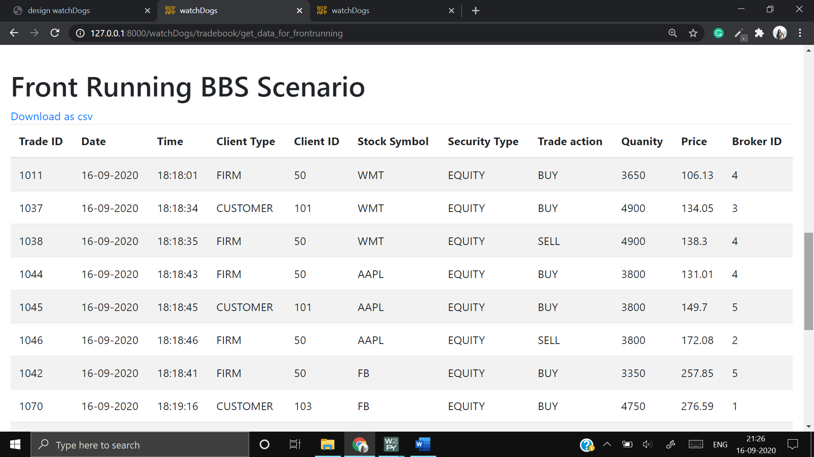
Results
All the transactions involved in front running buy-buy-sell scenario are detected and alerted to middle office.

Slide 14

Results
All the transactions involved in front running sell-sell-buy scenario are detected and alerted to Middle Office.

Slide 15

Results
All the brokers involved in Wash trade are detected and list is delivered to Trade Surveillance team

Slide 16
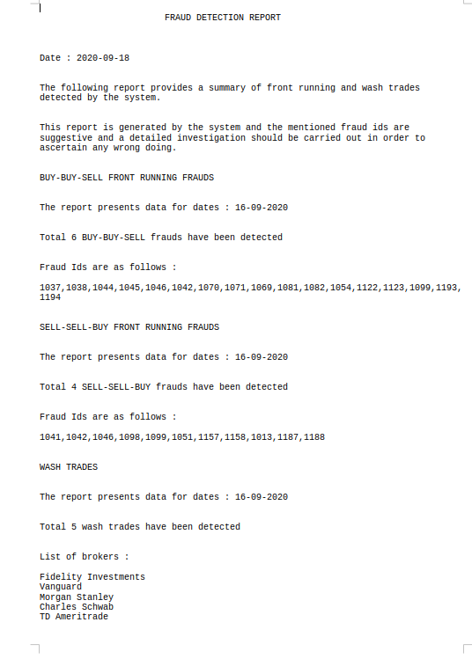
Results
A summary report is generated to middle office team involving fraudulent activities along with trade ID and brokers involved in the activity

